Slide 1


Slide 2



Slide 3
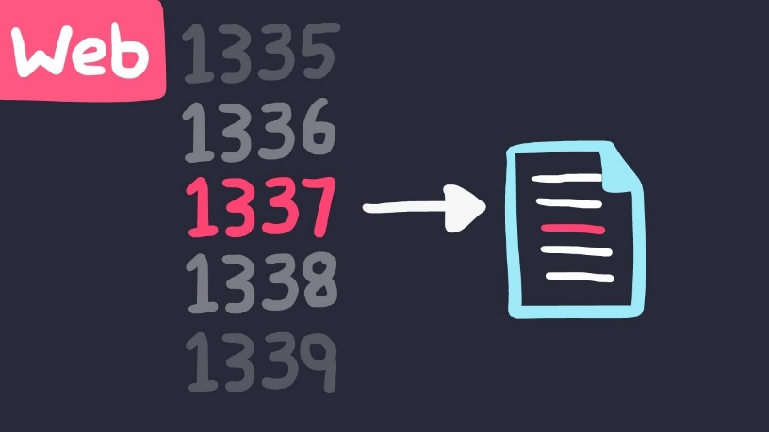
IDOR
Insecure direct object references (IDOR) are a type of access control vulnerability that arises when an application uses user-supplied input to access objects directly.
Example :
https://insecure-website.com/customer_account?User_ID=132355

Slide 4
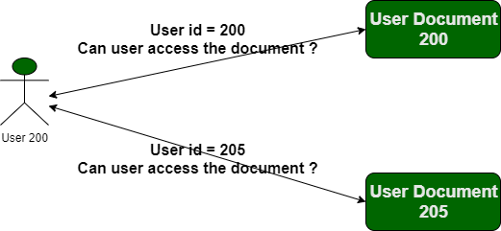

Slide 5
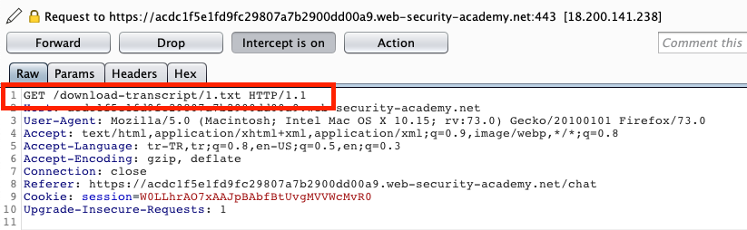
IDOR Vulnerability With Direct Reference To Static Files
IDOR vulnerabilities often arise when sensitive resources are located in static files on the server-side file system.
Example :
https://insecure-website.com/static/12144.txt

Slide 6
TYPES OF IDOR ATTACKS
Body Manipulation, in which attackers modify the value of a checkbox, radio buttons, APIs, and form fields to access information from other users with ease.
URL Tampering, in which the URL is modified at the client’s end by tweaking the parameters in the HTTP request.
HTTP Requests in which IDOR vulnerabilities are typically found in GET, POST, PUT, and DELETE verbs.

Slide 7
Impact Of IDOR Vulnerabilities
P1 – Account takeover, Access very important data (such as credit card)
P2 – Change / delete another users’ public data, Access private / public important data (such as tickets, invoice, payment information)
P3 – Access / delete / change private data (limited personal info: name, adress etc.)
P4 – Access any unimportant data

Slide 8


Slide 9

What are HTTP Headers?
Allows both the client and server to pass additional data along to the request or response to exchange information and inform the other party.
Request header examples:
Cookies
Accept-language: en-us
Response header examples:
Date
Content-type: text/html or application/json
Security-related headers

Slide 10
What are HTTP Security Headers?
Response headers that the server responds with to instruct the browser what security rules to enforce when it handles your website’s content.
Key value pairs
In general, the more security headers you opt-in to sending, the more secure your website is.
Most security headers come with multiple options you can configure to tweak the behavior to what you want.

Slide 11
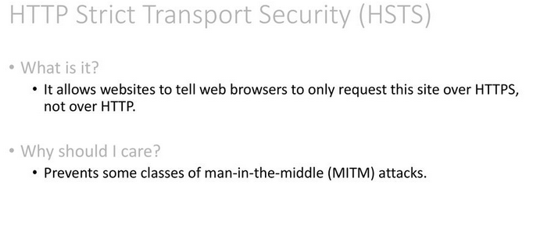
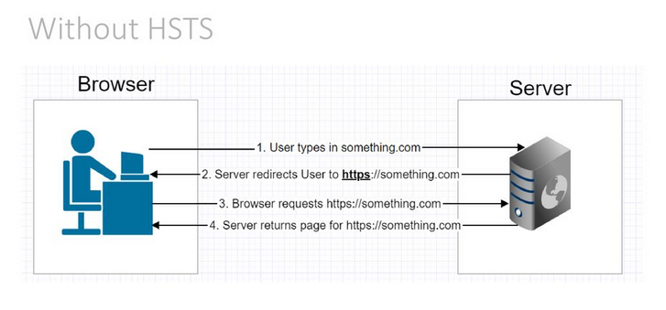

Slide 12
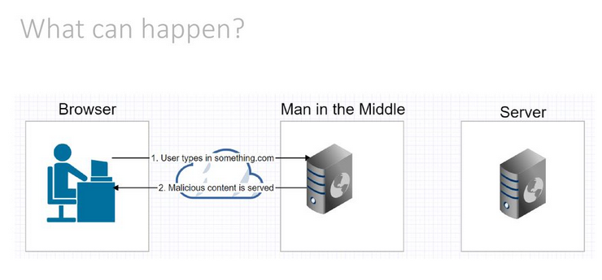
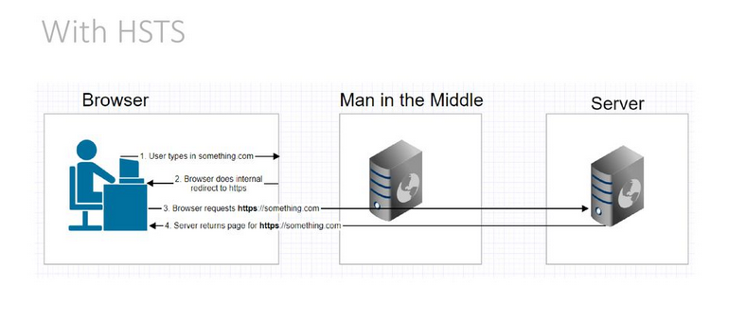

Slide 13
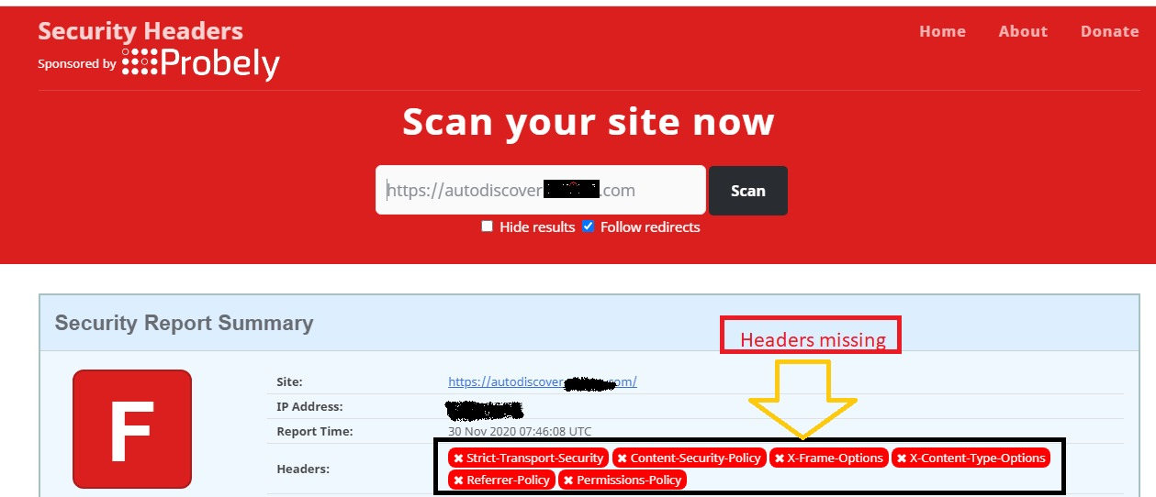
How to check Missing Security Headers Vulnerability
https://securityheaders.com/

Slide 14
THANK YOU

